Slide 1
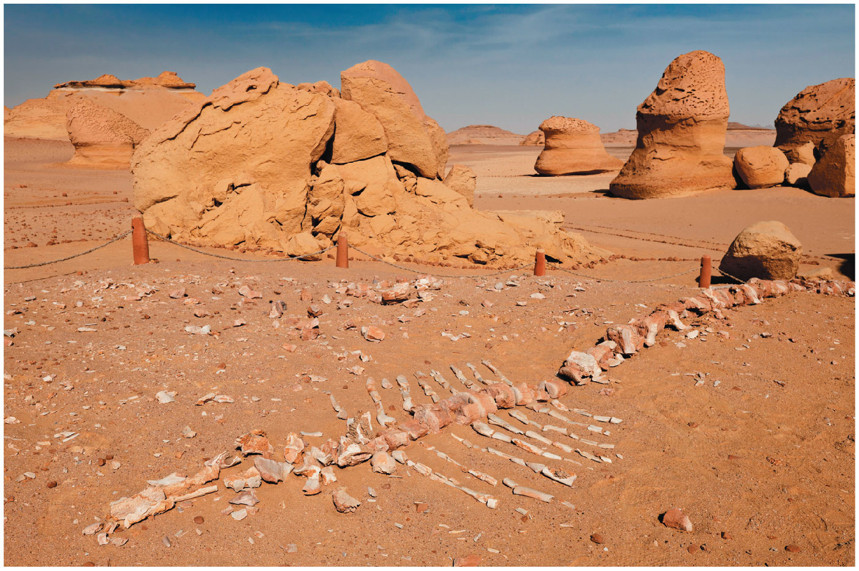
CH 25
LSU BIOL 1202
General Biology II Lecture
CHAPTER 25
The History of Life on Earth
Dr. Adam Hrincevich
Notes:
Figure 25.1 Would you have expected to find whale bones buried here?

Slide 2
CH 25 Learning Objectives
Describe steps by which simple cells may have originated from nonliving materials.
Explain what fossils are, how they are dated, and what the fossil record can reveal about life's history.
Identify when the origin of single and multi-celled organisms and the colonization of land occurred and explain the significance of these events.
Explain how plate tectonics, mass extinctions, and adaptive radiations have affected Earth's life.
Describe how changes in the sequence or regulation of genes can result in major changes in body form.
Use examples to show how novel and complex structures can arise by descent with modification.
I would suggest completing the crossword puzzle to help you understand the terminology and correlate how the terms relate to topics covered in this chapter.

Slide 3
Concept 25.1: Conditions on early Earth made the origin of life possible
Chemical and physical processes on early Earth may have produced
  Abiotic synthesis of
  Joining of these small molecules into
  Packaging of
  Origin of

Slide 4
Synthesis of Organic Compounds on Early Earth
Earth formed about
Earth was bombarded by rocks and ice vaporized water which prevented
Earth’s early atmosphere had little oxygen and likely contained
  EX:

Slide 5
5
In the 1920s, Oparin & Haldane independently hypothesized that
In 1953, the experiments of Miller & Urey showed that the
However, some evidence suggests that the early atmosphere was
The first organic compounds may have formed in reducing conditions near
Reanalysis of molecules formed in Miller’s experiments found that numerous amino acids formed under
  Summary of the Miller-Urey experiment HERE

Slide 6
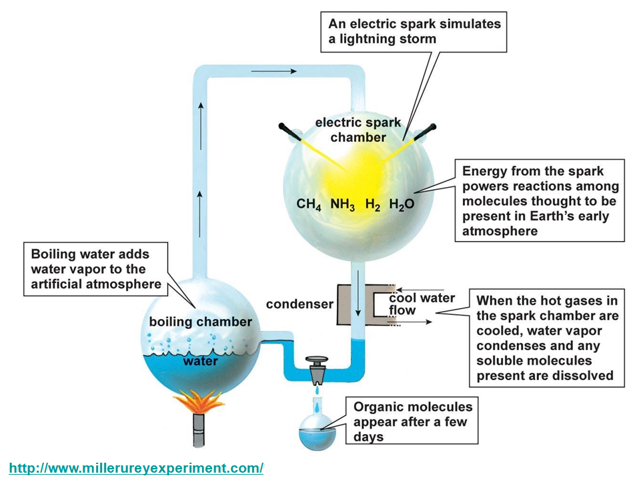
Miller-Urey
Experiment

Slide 7
7
Organic compounds may have been produced in deep-sea hydrothermal vents, areas on the seafloor where
Environmental conditions produced
“Black smokers” release
Alkaline vents release water with high
Conditions near alkaline vents were likely more

Slide 8
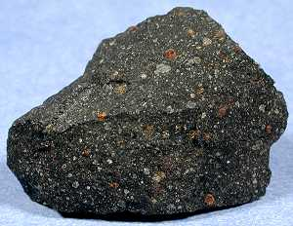
8
Meteorites may have been
Murchison meteorite is
  Fell in
  It was a
  Relatively
  Contain 80+ amino acids, other key

Slide 9
Protocells
Replication and metabolism are key properties of life and may
Protocells may have formed from
In water, lipids and other organic molecules can spontaneously
Adding montmorillonite, a soft
Vesicles show simple growth, reproduction, and metabolism and can absorb

Slide 10
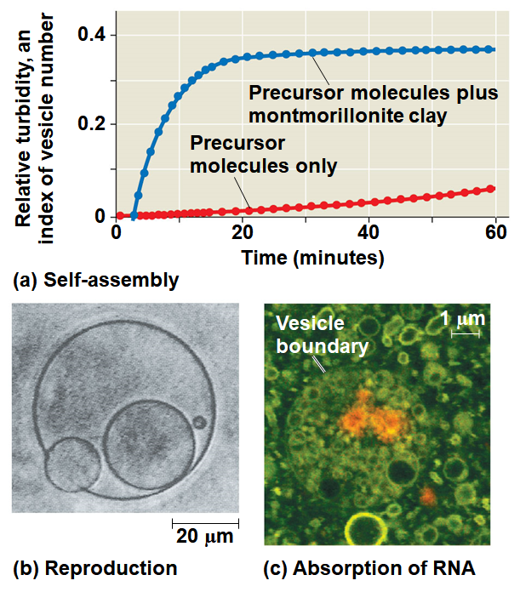
Figure 25.4
Notes:
Figure 25.4 Features of abiotically produced vesicles

Slide 11
Self-Replicating RNA
The first
RNA plays a
RNA molecules called
  EX: ribozymes can make
Natural selection has
Copying errors would have

Slide 12
12
RNA molecules that were more stable or replicated more
In 2013, researchers constructed a vesicle whose RNA could
If a vesicle on early Earth could grow, split, and pass on its RNA to
The most successful of the early protocells could have increased
RNA could have provided the
Double-stranded DNA is more

Slide 13
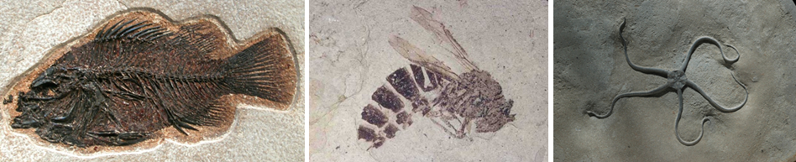
Concept 25.2: The fossil record documents the history of life
Few organisms have fossilized, and even fewer of the
The fossil record is
  Existed
  Were
  Had

Slide 14
How Rocks and Fossils Are Dated
The order of fossils in rock strata tells us
We can infer relative ages of fossils using this method, but
The age of a fossil can be
A radioactive “parent” isotope decays to a
Each isotope has a known half-life, the time required for
  EX: Li⁸ = < 1 second, Na²⁴ = 15 hrs, Ra²²⁸ =

Slide 15
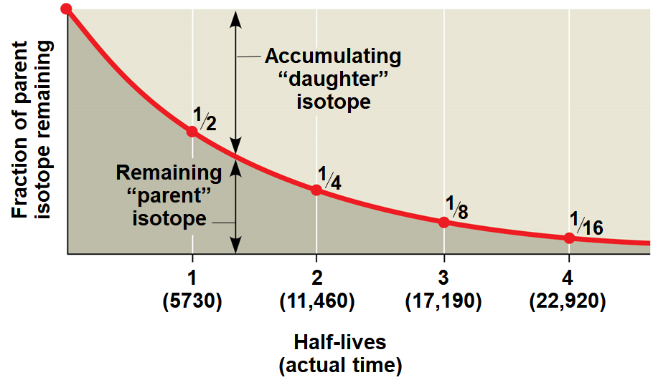
Figure 25.6
Carbon-14, the radioactive isotope of carbon used in carbon dating has a half-life of 5730 years, so it decays too fast. It can only be used to date fossils younger than about 75,000 years.
Notes:
Figure 25.6 Radiometric dating

Slide 16
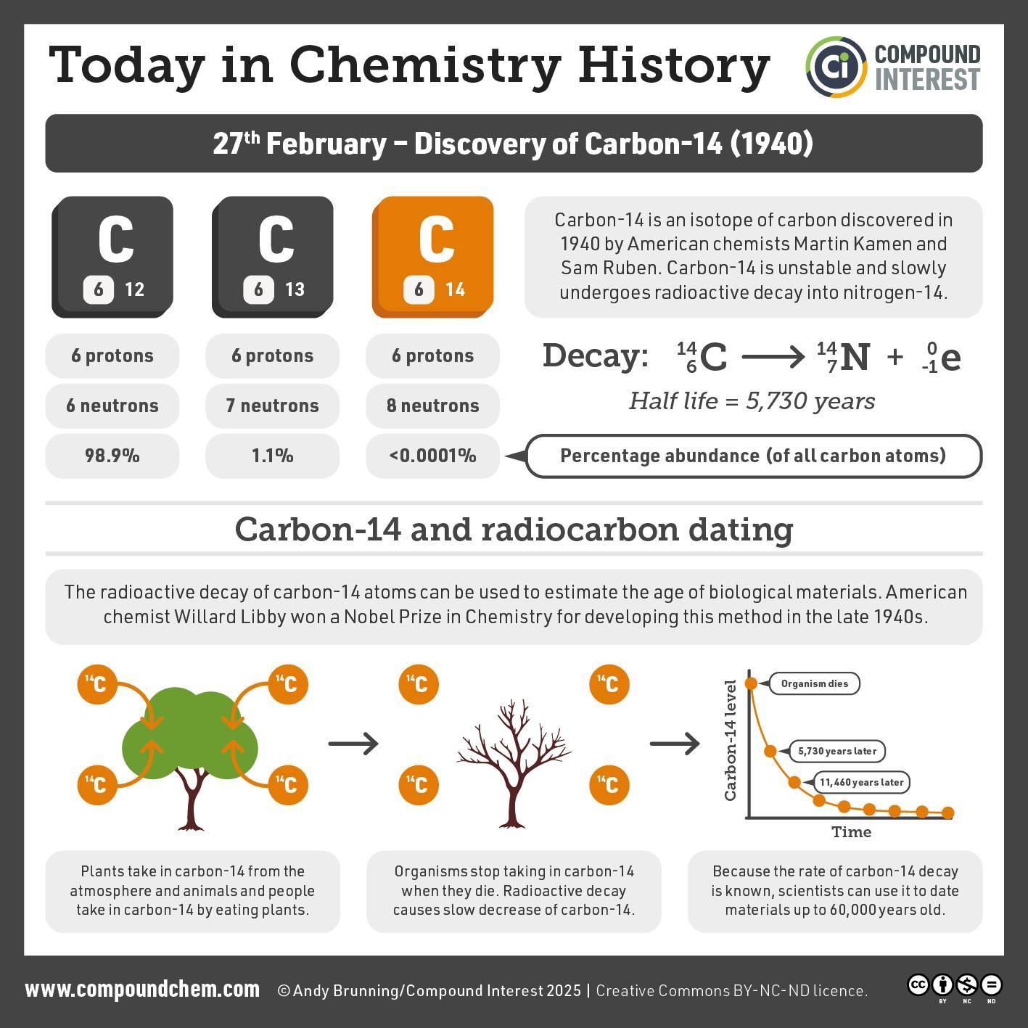

Slide 17
16
Fossils contain isotopes that accumulated in the organisms when
Ages are estimated using the ratio of C¹⁴:C¹² radioactive
Radiocarbon dates
Radioactive isotopes with
However, organisms
How do we date fossils >75,000 years old then?
The age of older fossils can be estimated by using isotopes with

Slide 18
Concept 25.3: Key events in life’s history include the origins of unicellular and multicellular organisms and the colonization of land
The geologic record is divided into the
The Phanerozoic eon includes the
The Phanerozoic is divided into 3 eras:
Major boundaries between eras correspond to major

Slide 19
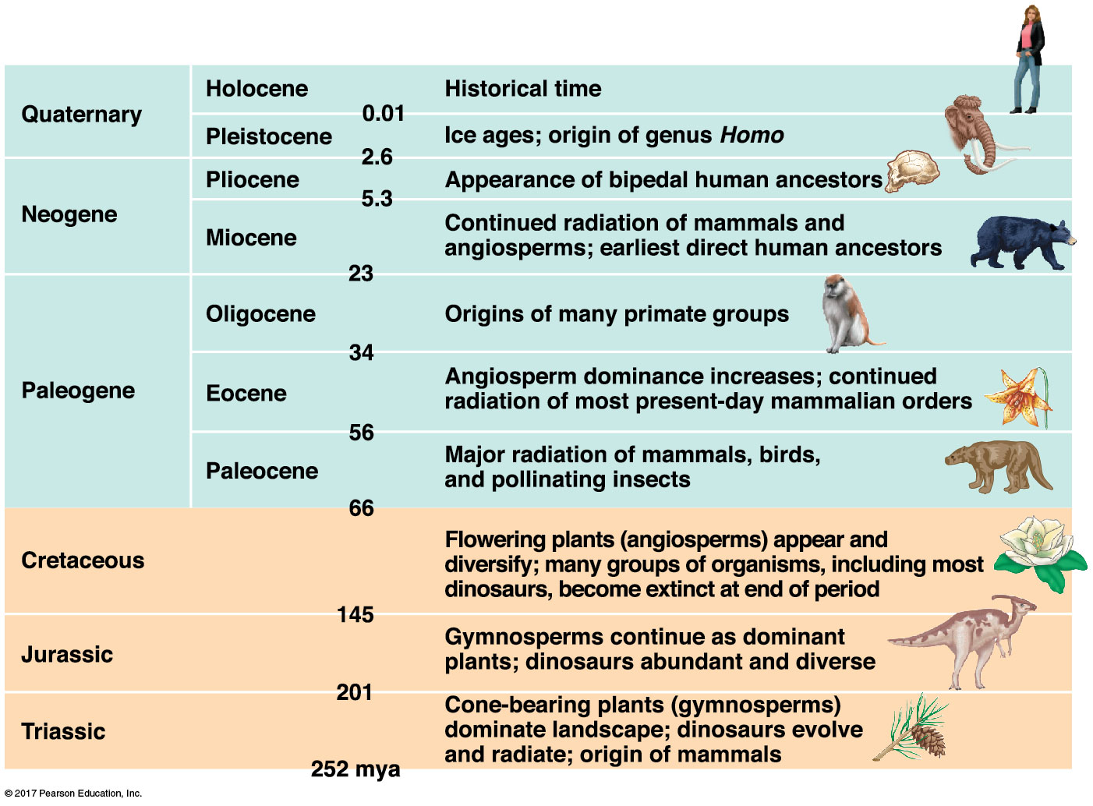
Table 25.1b
PRESENT DAY
<<<<<<<<< Phanerozoic eon >>>>>>>>
Notes:
Table 25.1b The geologic record (part 2: Mesozoic era and Cenozoic era)

Slide 20
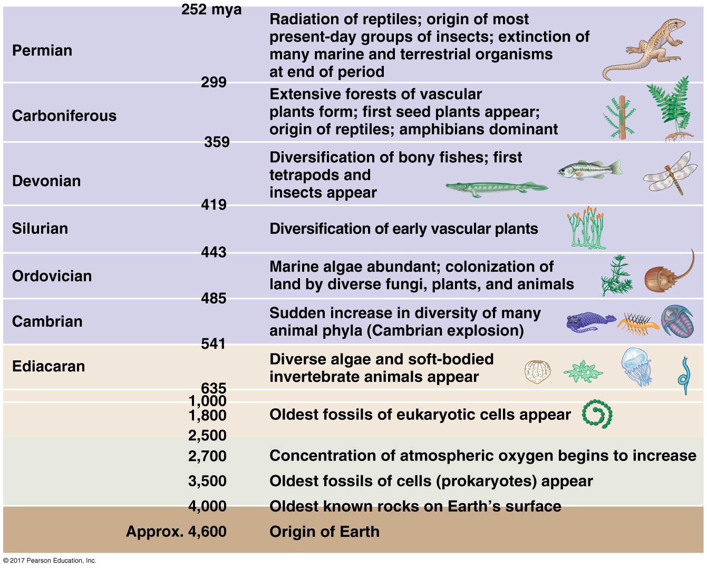
19
<<< Phanerozoic eon >>>
Hadean,
Archaean,
Proterozoic eons
<<< >>>
ORIGIN OF EARTH
Notes:
Table 25.1a The geologic record (part 1: Hadean eon through Paleozoic era)

Slide 21
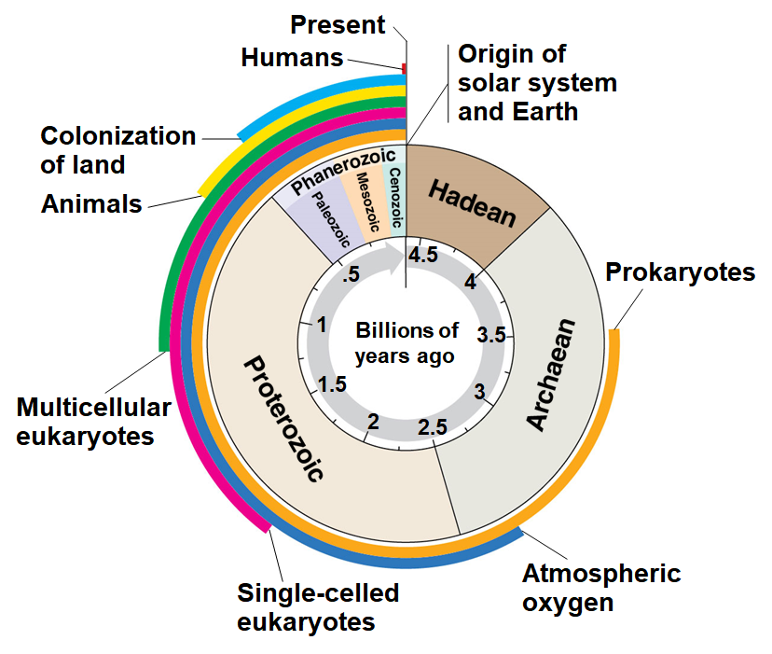
20
The analogy of a clock can be used to place the major events in the
The appearance and order of these 8 events is important. You should know these for the EXAM.
Notes:
Figure 25.8a Visualizing the scale of geologic time (part 1: timer)

Slide 22
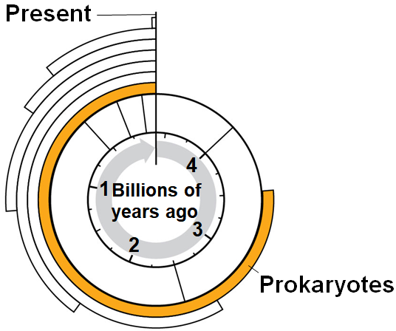
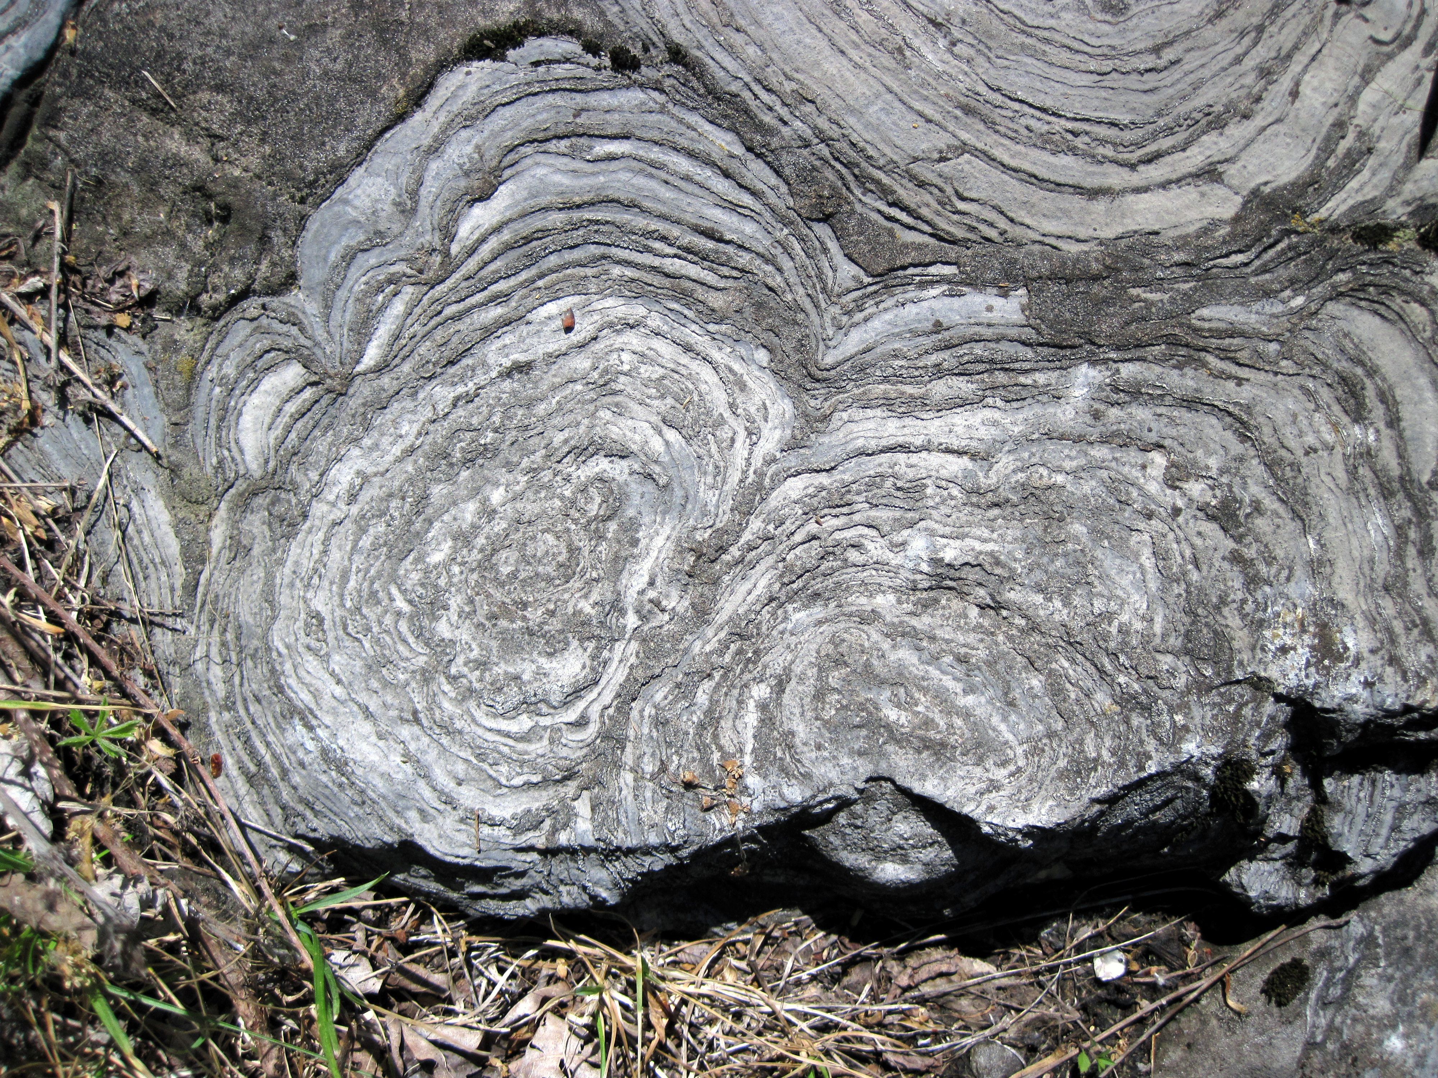
The First Single-Celled Organisms
The oldest known fossils are stromatolites, rocks formed by the accumulation of
Prokaryotes were Earth’s sole
Notes:
Figure 25.UN01 In-text figure, prokaryotes clock, p. 532

Slide 23
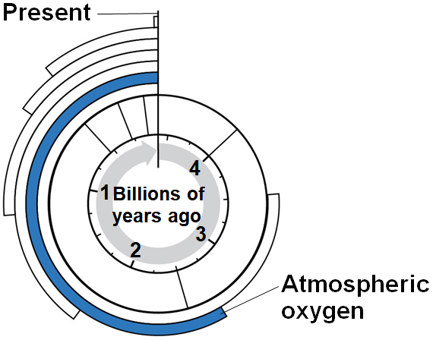
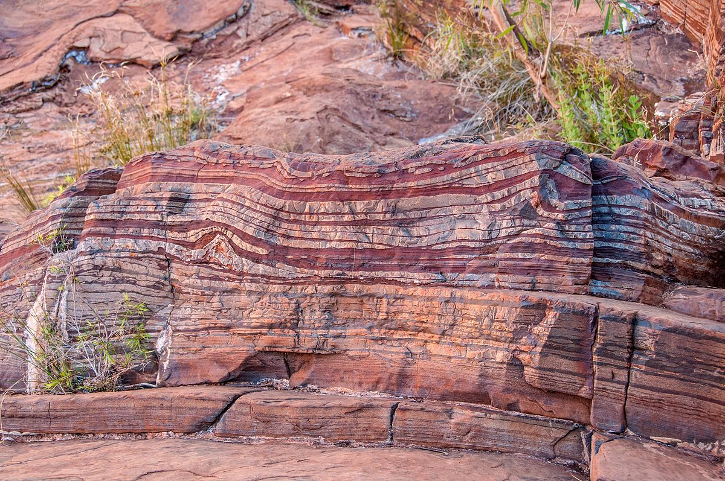
Photosynthesis and the Oxygen Revolution
Most atmospheric
O₂ produced by oxygenic photosynthesis reacted with
Notes:
Figure 25.UN02 In-text figure, atmospheric oxygen clock, p. 532

Slide 24
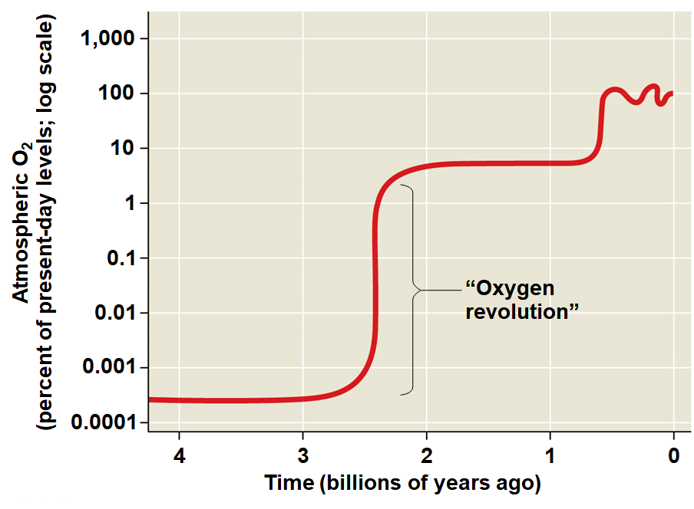
23
O₂ accumulated gradually in the atmosphere from about 2.7 to 2.4 BYA, and then shot
This “oxygen revolution” caused
Some groups survived in anaerobic environments; others

Slide 25
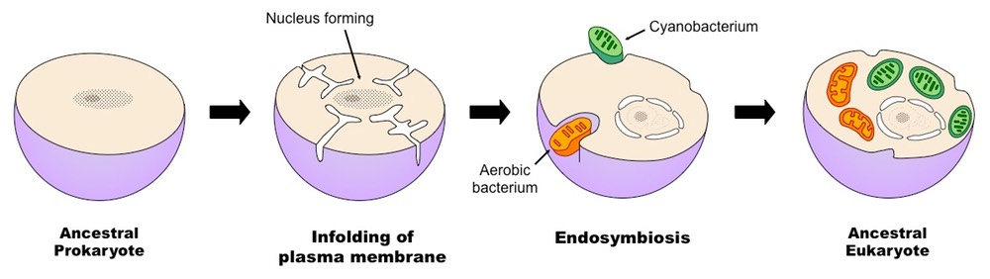
The First Eukaryotes
The oldest fossils of
Eukaryotic cells have a
Eukaryotes originated by endosymbiosis when a prokaryotic cell engulfed a
An endosymbiont is a

Slide 26
25
Anaerobic host cells would have benefited from endosymbionts that could
Over time, the host and endosymbionts would have become
All eukaryotes have mitochondria or remnants of mitochondria, but
Serial endosymbiosis supposes that mitochondria evolved before plastids through
Mitochondria and plastids likely descended from bacterial cells; the original host is

Slide 27
26
Key evidence supporting an endosymbiotic origin of mitochondria and plastids:
  Inner membranes of both
  DNA structure and cell division are
  Both organelles
  Ribosomes are more

Slide 28
Early Multicellular Eukaryotes
The evolution of eukaryotic cells allowed for a
A second wave of diversification occurred when multicellularity evolved and
The oldest fossils of multicellular eukaryotes are
Older fossils from about 1.8 BYA may also be multicellular

Slide 29
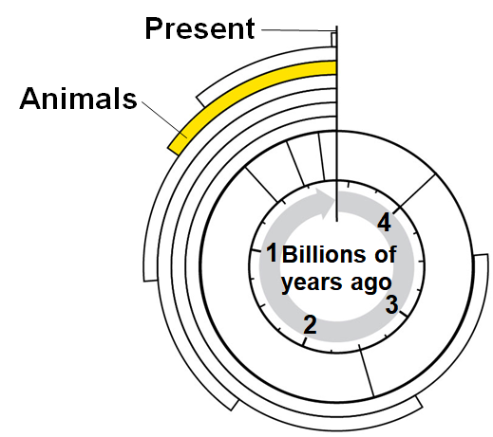
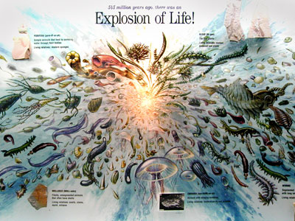
The Cambrian Explosion
The Cambrian explosion refers to the sudden appearance of fossils resembling
A few animal phyla appear even earlier:
Notes:
Figure 25.UN05 In-text figure, animals clock, p. 534

Slide 30
29
The Cambrian explosion provides the
Large-bodied predators with
New defense adaptations, such as
DNA analyses suggest that sponges evolved 700 MYA and the common ancestor to
The oldest fossil assigned to
Molecular and fossil data suggest that

Slide 31
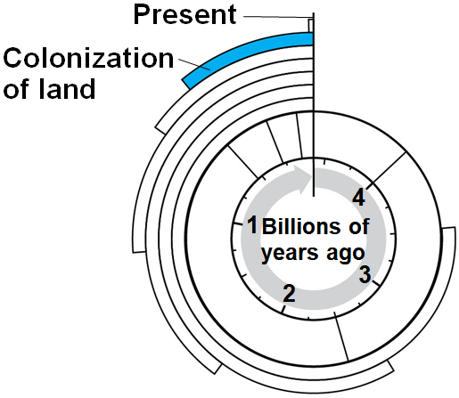
The Colonization of Land
Fungi, plants, and animals began to colonize land about
Many plants evolved adaptations to reproduce on land and
  EX: a vascular system for transporting materials appeared
Plants and fungi likely
Fossilized plants show evidence of
Notes:
Figure 25.UN06 In-text figure, colonization of land clock, p. 534

Slide 32
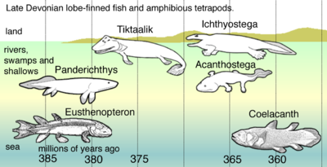
31
Arthropods and tetrapods are the most
Tetrapods evolved from
The human lineage of tetrapods evolved around 6-7 MYA, and

Slide 33
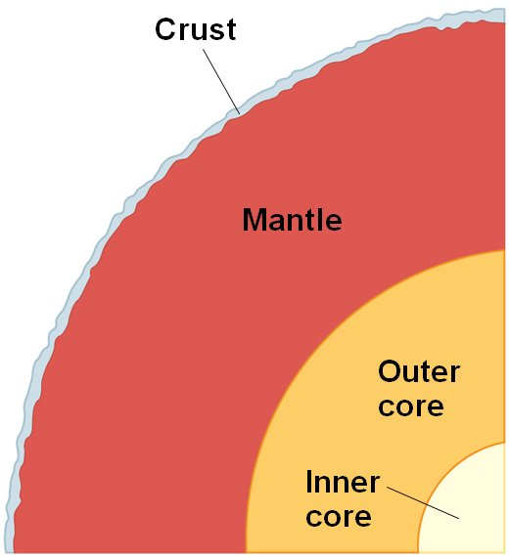
Plate Tectonics
Concept 25.4: The rise and fall of groups of organisms reflect differences in speciation and extinction rates
The landmasses of Earth have formed a supercontinent three times over the
According to the theory of plate tectonics, Earth’s crust is
Notes:
Figure 25.14 Cutaway view of Earth

Slide 34
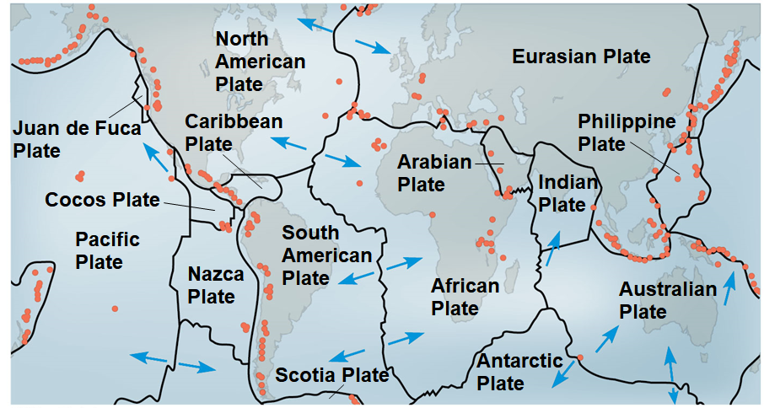
33
Movements in the mantle cause the plates to move over time in a
Oceanic and continental plates can drift apart, collide to form mountains, or slide past each other, causing earthquakes (Pangea rifting animation)
Notes:
Figure 25.15 Earth’s major tectonic plates

Slide 35
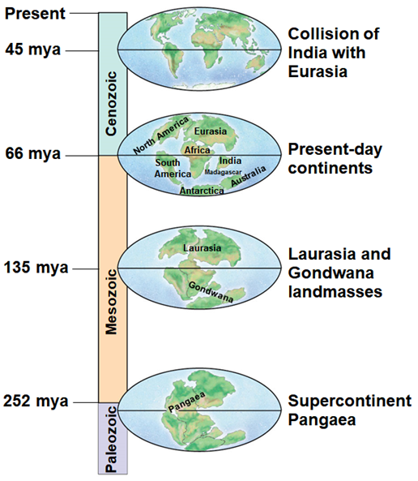
Consequences of Continental Drift
Formation of the supercontinent Pangaea about 250 MYA had
  deepening of
  reduction in
  colder and
  Separation of
Notes:
Figure 25.16 The history of continental drift during the Phanerozoic eon

Slide 36
Mass Extinctions
The fossil record shows that
Extinction can be caused by
At times, the rate of extinction has increased dramatically and
Historically, there have been
In each of the five mass extinction events,

Slide 37
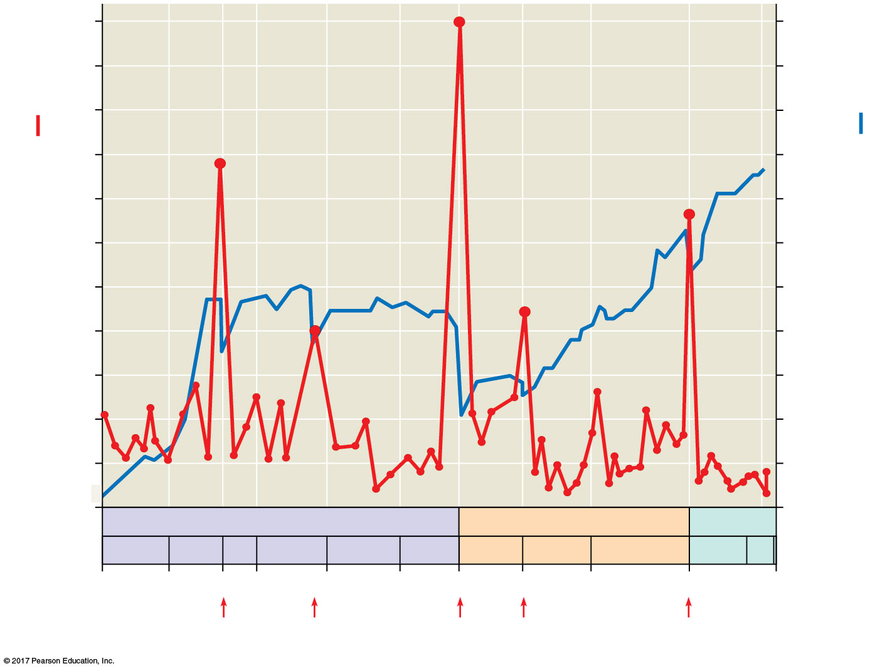
36
#3
1,100
25
1,000
#1
900
Total extinction rate
(families per million years):
20
#5
800
Number of extant families:
700
15
#2
600
#4
500
10
400
300
5
200
100
0
Mesozoic
0
Era
Paleozoic
Cenozoic
Period
C
O
S
D
C
P
Tr
J
C
P
N
Q
541
485
443
419
359
299
252
201
145
66
0
Time (mya)
Notes:
Figure 25.17 Mass extinction and the diversity of life

Slide 38
37
The Permian extinction (#3 on the previous graph) defines the boundary between
This mass extinction occurred in less than 500,000 years and caused the extinction of
A number of factors might have contributed to
  Extreme
  Global warming and ocean acidification resulting from the emission of
  Anoxic conditions resulting from

Slide 39
38
The Cretaceous mass extinction (#5 on the previous graph) occurred
More than half of all marine species, many families of terrestrial plants and animals, and all of the dinosaurs, except
The presence of iridium in sedimentary rocks from that time period suggests
The Chicxulub crater off the coast of Mexico is evidence of a
Dust clouds caused by the impact would have

Slide 40
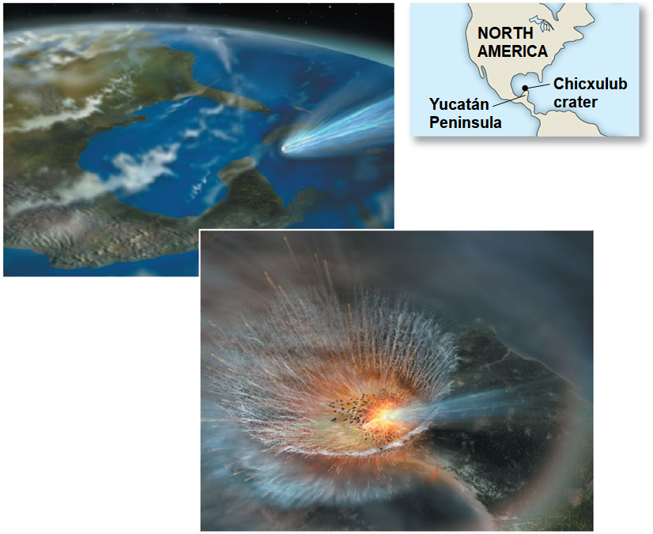
Figure 25.18
Notes:
Figure 25.18 A trauma for Cretaceous life

Slide 41
Is a Sixth Mass Extinction Under Way?
Scientists estimate that the current rate of extinction is
It is difficult to estimate current extinction rates because many undiscovered species may be lost through
Many species are declining rapidly due to
Climate change may hasten declines; extinction rates historically have tended to
Data suggest that a 6th,

Slide 42
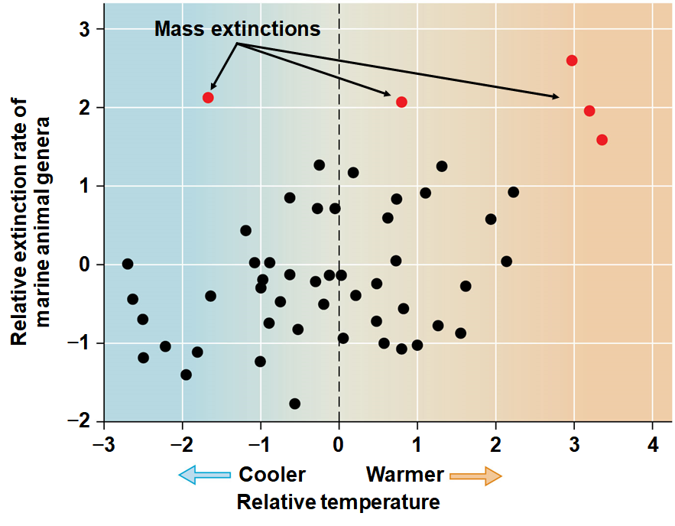
Figure 25.19
Notes:
Figure 25.19 Fossil extinctions and temperature

Slide 43
Consequences of Mass Extinctions
It typically takes 5-10 million years for diversity to recover following a
Mass extinctions can change the types of organisms found in
  EX: the proportion of predators increased in marine communities after the
Mass extinctions can also eliminate lineages with novel and
  EX: shell-drilling gastropods were lost in the extinction at the end of the

Slide 44
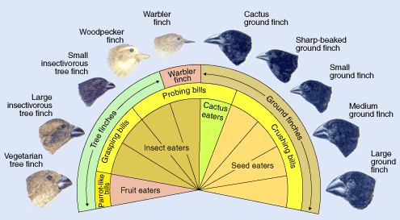
43
Adaptive radiation is the rapid evolution of diversely adapted
Adaptive radiations may follow
  the
  the

Slide 45
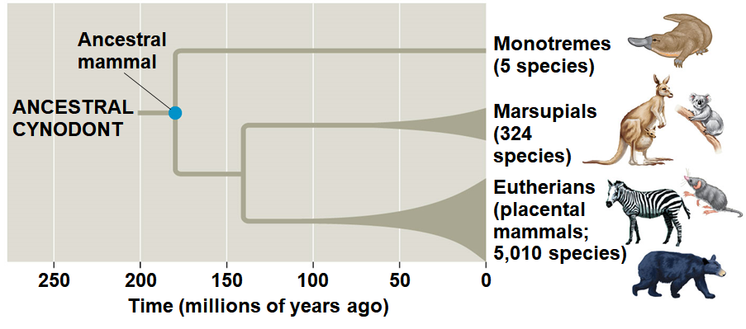
Worldwide Adaptive Radiations
Mammals underwent an adaptive radiation after the
The disappearance of dinosaurs (except birds) opened ecological niches, allowing for the
Other notable radiations include photosynthetic prokaryotes, large

Slide 46
Concept 25.5: Major changes in body form can result from changes in the sequences and regulation of developmental genes
Studying genetic mechanisms of change can provide insight into
Developmental genes are those that control the rate, timing, and spatial pattern of changes in an organism’s
Heterochrony is an evolutionary change in the rate or timing of developmental events; it can have a significant
  EX: Contrasting shapes of human and chimpanzee skulls are the result of

Slide 47
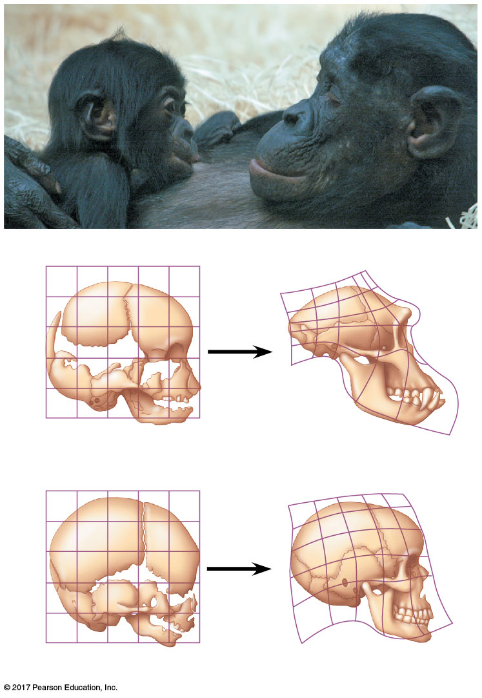
Figure 25.23
Chimpanzee infant
Chimpanzee adult
Relative skull growth rates
Chimpanzee fetus
Chimpanzee adult
Human fetus
Human adult
Notes:
Figure 25.23 Relative skull growth rates

Slide 48
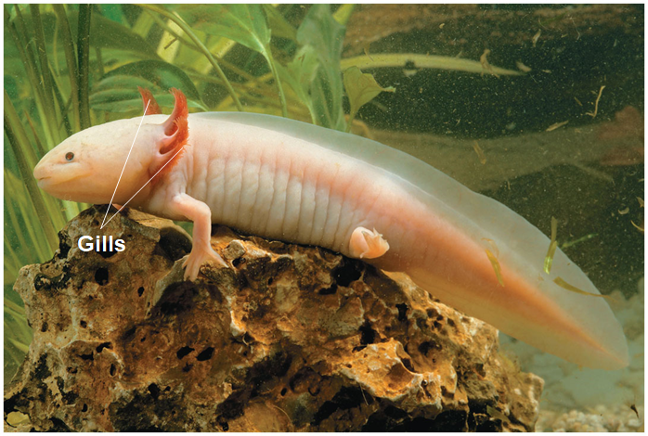
47
Heterochrony can alter the timing of reproductive development relative to the
In paedomorphosis, reproductive development rate accelerates
The sexually mature species may retain body features that were
Notes:
Figure 25.24 Paedomorphosis

Slide 49
Concept 25.6: Evolution is not goal oriented
Evolution is like tinkering; it is a process in which new forms arise by
Most novel biological structures evolve in many stages from
  EX: Complex eyes have evolved from simple photosensitive
Structures do not evolve in anticipation of future use; natural selection can only improve a structure in the context of
Fossil records show
Extracting a single evolutionary progression from the

